Slide 1

CUSTOMER SEGMENTATION majid al Futtaim - najm
Capstone Review Phase 1

Slide 2
AGENDA
Introduction
Industry Understanding
Client Understanding
Problem Breakdown
Next Steps
Notes:
Let’s look at agenda of this presentation. Starting off with a quick overview of the credit card industry worldwide, we move on to see how the industry performs in the Middle East and North Africa, as it’s the region where our client is established. Then dive into our client profile. Further on, let’s breakdown our problem statement and look at some next steps on solve it.

Slide 3
introduction

Slide 4



Problem at hand
The credit card business of the company (NAJM) is interested in capitalizing untapped acquisition potential within its movie customer base (VOX).
Majid Al Futtaim
NAJM
VOX
Customers of Interest

Slide 5




















MAF and its holdings
Consumer Finance
“Great Moments For Everyone Everyday”
560M
Grocery
Retail
13
Hotels
Visitors Annually
306 Outlets
15 Countries
Since 1992
26
Shopping
Malls
Cinemas
500+ Screens
50+ Locations
40K
Employees
Fashion
Notes:
Founded in 1992, MAF is the leading shopping mall, retail and leisure pioneer across the Middle East, Africa and Asia.
A remarkable business success story, MAF started from one man’s vision to transform the face of shopping, entertainment,, finance and leisure to ‘create great moments for everyone, everyday’.
MAF owns and operates 26 shopping malls, 12 hotels.
Grocery Retail includes Carrefour Franchise in 38 markets across MENA and operates a portfolio of more than 306 outlets in 15 countries.
MAF operates 500+ VOX cinema screens spread across 50+ locations.
Consumer Finance Company - NAJM

Slide 6




Maf - Current State
Revenue
$9.57B
1.45%
^EBITDA
$1.26B
0.64%
Spread over 15 locations across MENA
Focus on diversification
Established track record, reputation and brand
26
Shopping Malls
200M
Customers
(As of 2020)
42
*New Carrefour Stores
306
Total Stores
146
*New VOX Screens
511
Total Stores
* - From 2019 to 2020
6
^EBITDA - Earnings Before Interest, Taxes, Depreciation, and Amortization
Data source: Majid-Al-Futtaim-Investor-Presentation (2020)

Slide 7
Industry understanding
Notes:
Our client is a Credit Card Business in the Middle East and North Africa. So, before getting to know our client, let’s see the various aspects of a credit card business and some stats related to it.

Slide 8



Global insights on credit card industry
2.8B
Cardholders worldwide
Credit Card Networks - Market Share
Gen X
Prefer Credit Cards
Data source: Shift Processing
4
Average No. of Credit Cards per American
Data source: Nilson Report
Notes:
2.8 billion Credit Cardholders worldwide, Out of which U.S accounts for 1.6 billion.
Gen X prefer using credit cards, compared to Millennials and Gen Z. Younger consumers typically prefer to use debit cards over credit cards, especially when choosing a default payment method for digital payments.
The average number of credit cards per American is 4. Around 14% of the Americans have 10 credit cards.
4. Visa leads among the most popular credit card networks with 53% market share followed by Mastercard, Discover and American Express.

Slide 9



Credit card industry in mena region
% of Population having Credit Cards
1/3rd
Of MENA’s CCs is in UAE
1 in 3
People have >1 CC in UAE
Data source: Veriskfinancialresearch
$209
Pre-tax profit in UAE
(per customer annually)
The figures underline the UAE's importance in the region's credit card industry despite its relatively small population
BUY NOW, PAY LATER
Data source: Gulf News
Notes:
The figures underline the UAE's importance in the region's credit card industry despite its relatively small population, he said. While 59 per cent of UAE residents own credit cards, just five per cent of Saudi residents have credit, and a paltry 1.9 per cent in Egypt own credit cards.
UAE holds 1/3rd of the credit cards in circulation in the Middle East region.
One in 3 people have more than one credit card in UAE
Visa and Mastercard are still popular choices.
UAE is one of the most profitable card markets with the avg. pretax profit per CC amounting to $209 in 2018
The market is dominated by Visa and Mastercard, which together represented 99% market share both in terms of the number of credit cards in issue, as well as billed volume in 2018.
https://gulfnews.com/business/banking/uae-has-a-third-of-regions-credit-cards-1.130846

Slide 10
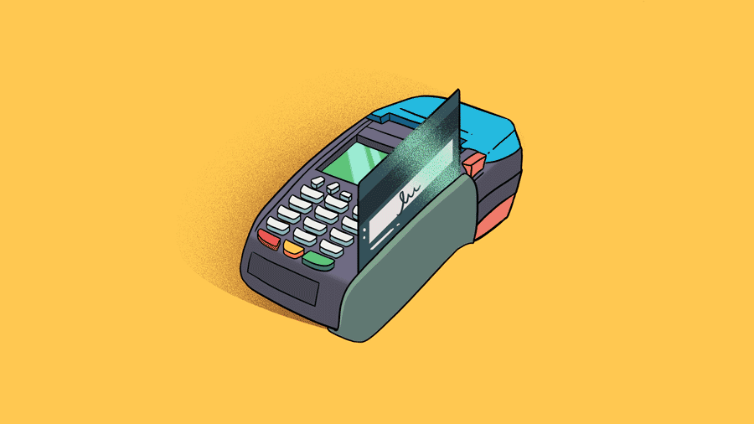

Do you know how a credit card transaction happens?
Let’s get an overview!

Slide 11








Stakeholders – credit card transaction
Transaction Cycle
Cardholder
Issuing
Bank
Card Network
Authorization
Funding & Settlement
Merchant
Merchant
Bank
Processor
Data source: Fisglobal (2019)
Notes:
A cardholder obtains a credit card from an issuing bank, uses the account to pay for goods or services.
A merchant is any type of business that accepts card payments in exchange for goods or services.
A merchant bank establishes and maintains merchant accounts. Merchant banks allow merchants to accept deposits from credit card payments.
Payment processors are companies that process credit card transactions. Payment processors connect merchants, merchant banks, card networks and others to make card payments possible.
Issuing banks are the banks, credit unions and other financial institutions that issue credit cards to cardholders through the card associations.
Card Network include Visa, Mastercard, Discover and American Express. The card associations set interchange rates and qualification guidelines, and act as the arbiter between issuing banks and acquiring banks among other vital functions.

Slide 12






Transaction cycle - Authorization
Card Details & Purchase Amount
Approval Status
Issuing
Bank
Data source: Fisglobal (2019)
Notes:
First, let’s look at the authorization process.
The cardholder presents their card (or other secure method) to a merchant in exchange for goods or services.
The merchant sends a request for payment authorization to their payment processor.
The payment processor submits transactions to the appropriate card association, eventually reaching the issuing bank.
Authorization requests are made to the issuing bank, including parameters like CVV, AVS validation and expiration date.
The issuing bank approves or declines the transaction. Transactions can be declined for insufficient funds or available credit, if the cardholder’s account has been closed or expired, if a payment is past due or other factors.
The issuing bank then sends the approval (or denial) status back along the line to the card association, merchant bank and finally to the merchant.

Slide 13



Transaction cycle – funding & settlement
Transaction Details
Transaction Details
Sends
Money
Transaction Details
Deposits Money
Adidas’s Bank
My Bank
Data source: Fisglobal (2019)
Notes:
Merchants send batches of authorized transactions to their payment processor.
The payment processor passes transaction details to the card associations that communicate the appropriate debits with the issuing banks in their network.
The issuing bank charges the cardholder’s account for the amount of the transactions.
The issuing bank then transfers appropriate funds for the transactions to the merchant bank, minus interchange fees.
The merchant bank deposits funds into the merchant account.

Slide 14
HOW DO CREDIT CARD COMPANIES MAKE MONEY?

Slide 15


How do credit card companies make money?
Full-Payers
Traders
Dormant Users
Revolvers
Non-Payers
SOURCES OF INCOME
Interest Charges
Interchange Fee
Types of CC users
Annual Fee
Foreign Transaction charges
Cash advance Fee
Conversion of outstanding amount
Notes:
TYPES OF CC users
Max Payers or Full Payers: These are the most responsible kind of people. They have an idea of what the statement would be in advance and prepare for the expense. They are not the kind of payers that a credit card company makes money from. However, they pay back, thereby allowing the credit card issuer to keep the money in circulation.
Revolvers: They pay only the minimum amount due, or little more than that, and go about making purchases on their cards as usual. High interest rates do not bother them. No matter how big or small the outstanding amount, they believe in revolving their credit, hence earning their name. The companies make money at their expense. Revolvers can have their credit scores make a downside dash.
Non-Payers: Contrary to the first two categories, non-payers manage to obtain all the credit cards offered to them, use them all up to the maximum available credit and then not pay up at all. These are the type of customers that any credit card company would not like to have.
Traders: Traders are the smartest credit card users. They are always on the lookout for cards with maximum rewards, cash back, longest payback tenure etc. After using the maximum amount on a card and cashing in the reward points, they are on the pry for cards that offer transfer of balance without any fee or have least rate of interest.
Non-Users: Non-users are typically those people who have previously gotten into trouble for using their card wrongly or those who like to be extra cautious with their expenditure.
SOURCES OF INCOME
Late payment fee/Revolving Interest Charges
A significant amount of card users does not pay their bills in full each month.
The customer’s unpaid credit card balance starts to incur interest at rates varying roughly from 1.75% to 4% per month (APR varies between 16% to 48%).
Among a card company’s customer base, majority would be “revolvers” (people who keep paying less than full amount every month), and these guys are most profitable for the bank.
Interchange Fee
Every time you use CC, the merchant pays a processing fee.
The portion of this fee sent to the issuer bank via the payment network is called “interchange” (usually about 1% to 3% of the transaction).
These fees are set by payment networks and vary based on the volume and value of transactions.
Other sources include –
Annual fees charged to cardholders -
American Express Platinum Travel Credit Card has joining fees of Rs.3,500, and Rs.5,000 is the annual fees from the subsequent year onwards.
Foreign Transaction Charges
A foreign currency conversion charge is levied to your account.
Cash Advance Fees
When customers use their credit card to get cash at an ATM. (2% to 3% of the amount of cash taken out).

Slide 16




tactics used to target customers
Most Important Credit Card Feature
TARGET CUSTOMERS
Credit Approval
High Income
Cash-back
Point-rewards
Mileage offers
Low/No Fees
Rewards
Low Income
Low introductory APR
APR
Add source
Data source: Trellist
Notes:
Mileage cards tended to have much higher interest rates. They also had lower late fees and other gotcha features. The kinds of cards aimed at rich, educated people did not seem interested in making money off financial mistakes like the occasional late payment.
(Cards with travel rewards epitomize the kind of product aimed at the rich and educated. It is an exclusive niche - only about 8 percent of credit card offers fall into this category.)
The card offers sent to poorer, less educated people were often loaded with risky features: Low introductory APRs, high late fees, and penalty interest rates that kick in if you break the rules.
(Poorer people usually have worse credit, so standard economic theory predicts their regular APR should be higher. So CC companies use low APR to real them in. On the contrary the late fees, the hidden fees, the fees that hit you when you fall behind on your payments - are all high for the poor as they are more likely to be sloppy with their finances.
Savvier customers are careful to pay on time and never blow their credit limits. Because they are less likely to make financial mistakes, educated people are offered more straightforward deals from credit card companies
If you only make purchases and pay off your ending balance each month by the due date, you pay just the amount you owe with no interest. However, if you opt to carry a balance on your card, you pay the agreed-upon interest on your outstanding balance.
https://www.trellist.com/insights/detail/data-driven-insight-on-millennials-for-credit-card-issuers

Slide 17
Client understanding

Slide 18

18

Slide 19





Najm - statistics
Customers
Employees
110K
500+
Credit Cards
Pre-paid cards/Day
175K
2000
Since 2008
Financial Services & Solutions
MENA Region
Top choice - Travelling
Spends
$3B
Data source: Issuu
Notes:
https://issuu.com/thenajmroundup/docs/internal_companyprofile_july2018
Founded in 2008.
Offer financial services and solutions with branchless banking and world class customer service.
Empower customers across Middle East and North Africa
Top choice for people travelling frequently.
110k CC customers
500+ employees
175K CC in force
3B CC spends
2000 prepaid card sold per day

Slide 20

NAJM Credit cards
Salary Range | AED 7000 – AED 15000
Annual Fees | AED 0 – AED 499
Cashback | YES
Balance Transfer | YES
Interest Rates | 3.25% per month
Offers | 10% cashback Up to 50% on dining & movie ticket bookings Reward points on every AED spent
Top Credit Cards | NAJM Platinum Cashback CC NAJM One Cashback CC NAJM Platinum Plus Cashback CC NAJM Voyager Signature CC
Data source: Issuu

Slide 21

Swot analysis
WEAKNESSES
The pre-existing customer base is
not content
Cashbacks do not reach customers
on time
STRENGTHS
Exclusive travel rewards and benefits
Domestic brand trusted by
locals
OPPORTUNITIES
Acquisition potential of customers within MAF umbrella
Capitalizing profitable customers from VOX
THREATS
Global established brands
in the industry
High market share of these competitors

Slide 22
Problem Definition

Slide 23



CURRENT STATE
STRATEGIES
FUTURE STATE
Desired customer acquisition goals set by NAJM was not achieved
NAJM's business revenue and growth was stagnant
Interested in acquiring profitable customers
Wants to target pre-existing MAF customer portfolio
Finds high customer acquisition potential within VOX movie customer base
Acquire profitable customers from VOX customer base into the NAJM chain
Defining factors to deem customers as profitable
Identifying appropriate customers to target based on the relevant metrics
Grouping them based on similar characteristics
Tailoring acquisition campaigns that would best fit the segmented groups
Delivering unique selling point to the customers
Profitable acquisition campaigns
Enhanced business performance
Higher conversion rates
Expansion of current customer base
Increased revenue and cross-sales ratio
Innovation
Rise in brand value and awareness
Preferred payment partner in VOX industry

Slide 24
Co.dx problem definition
Business Opportunity
Analytics Problem
Analytics Outcome
Business Outcome
Acquire potential customers from VOX to NAJM
Design a framework to identify target group of customers who will purchase NAJM credit cards
Accurate segmentation of customers based on the behaviours exhibited
Clear picture for the company on targeting the customers
Ability to cross-sell NAJM cards to VOX customers
Acquiring more profitable customers
Getting insights on customers who use NAJM CC for payments at VOX
Framework that identifies profitable customers and targets them

Slide 25

Next steps
Implementation
Modelling
Validation
Solution
Approach
Perform EDA
Hypothesis Testing
Project Lifecycle
Product
Consumption
Data
Data Collection
Data Cleaning
Business Understanding

Slide 26
QUESTIONS ?

Slide 27
THANK YOU

Slide 28
Appendix
VOX Cinemas - Overview
Co.Dx Screenshot
Client Empathy Map

Slide 29



Vox - statistics
Customers
Employees
50M+
100+
Screens
Since 2000
511
Great Moments for Everyone, Everyday
Most innovative, customer-focused exhibitor
Middle East’s largest and most rapidly growing cinema.
Spread across 50 locations with a total of 500+ screens.
Revenue
Order Online
17M
(as of 2020)
Home Delivery
Data source: Zoom Info

Slide 30
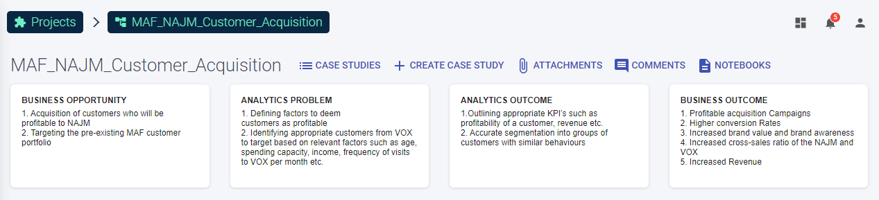
Co.dx screenshot

Slide 31

Mr. Sumeet Pundlik, Director- Corporate & Retail Cards Acquisition, NAJM
What does he feel/think ?
Responsible for company’s Sales Decision
Improve customer satisfaction by anticipating consumer needs
Wants to devise new Sales tactics
What matters to him ?
What influences him ?
Increase customers in his region of operation
Attracting profitable clients
Identifying where improvements can be made and developing success-driven plans
Close relationship with the marketing department
Has a close eye on the sales tactics used by competitors
Out of the box ideas driven by new technologies
What are his biggest hurdles ?
What are his short- term goals ?
Loyalty of the current customer base
Incompetency of the Sales Team
Ineffective Credit Card Schemes
Running successful acquisition campaigns
Use analytics to target customers
Attracting customers by claiming to protect them from fraudsters

